Slide 1
Image Compression with Deep Learning Colourization (ICDLC)
Michael Chyziak – 301170717
mchyziak@sfu.ca
ENSC 424 – Fall 2018

Slide 2
Overview of ICDLC
Compress colour image by taking only greyscale component
3:1 compression
Keep extra side information to help "decode" image
Pass greyscale image and side information to Neural Network to colourize
Combine output of Network with greyscale image to get final image

Slide 3
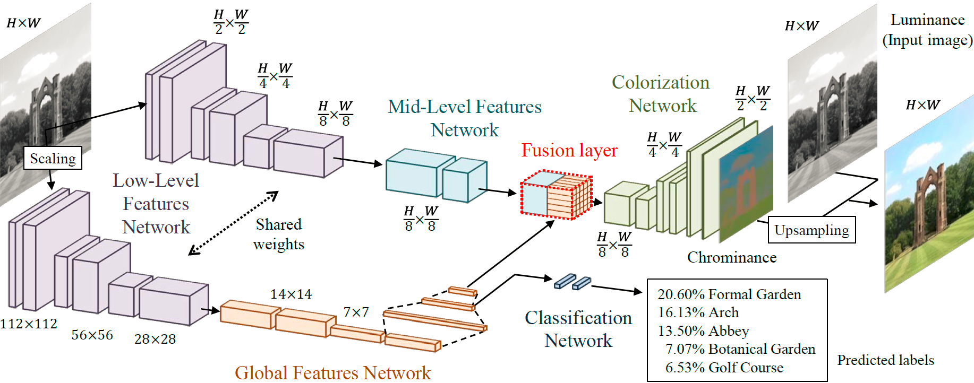
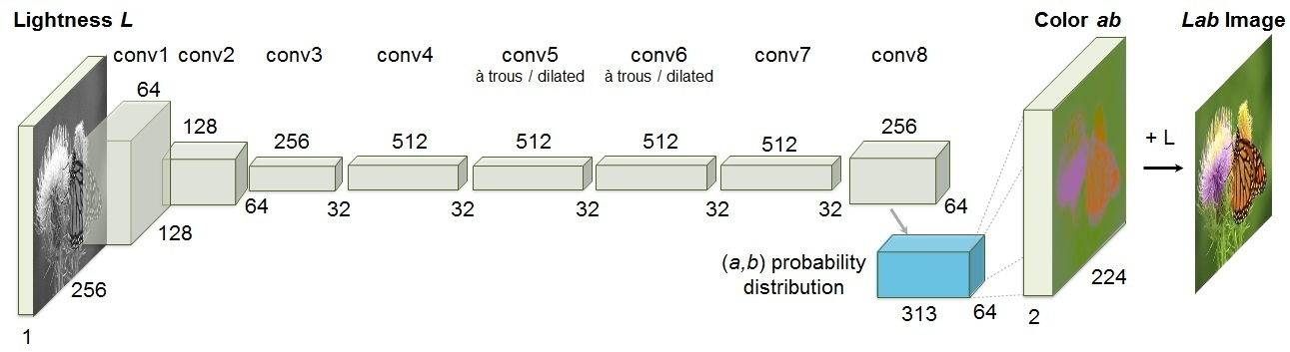
Current Colourization
Joint End-to-end Learning of Global and Local Image Priors for Automatic Image Colorization with Simultaneous Classification
Colorful Image Colorization

Slide 4
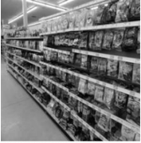
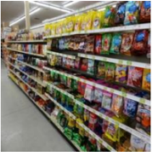
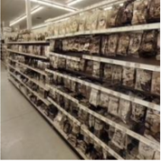
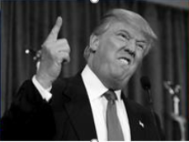
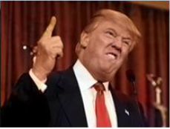
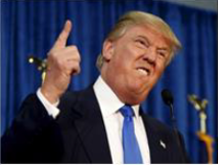
Problems with Colourization
Hard to output images with vibrant colours
Hard to restore original colours
GreyScale Original Predicted

Slide 5
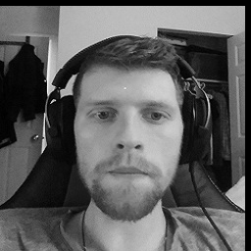
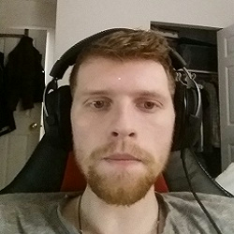
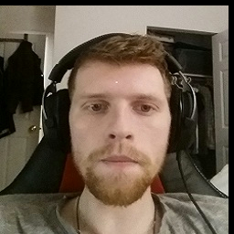


ICDLC Encoding
Original Image (250x250)
GreyScale of image (PNG/JPG)
COMPRESSED DATA
Compress by 32 (8x8)
Save CbCr values
Convert to 256x256

Slide 6
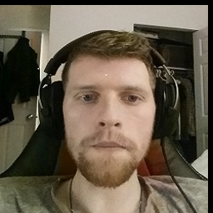
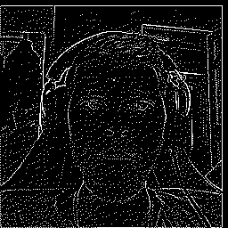
ICDLC Decoding
Combine Greyscale with predicted CbCr values
Detect Edges
COMPRESSED DATA
Neural Network
PREDICTED DATA
Input Greyscale, 8x8 CbCr, Edge into Network

Slide 7
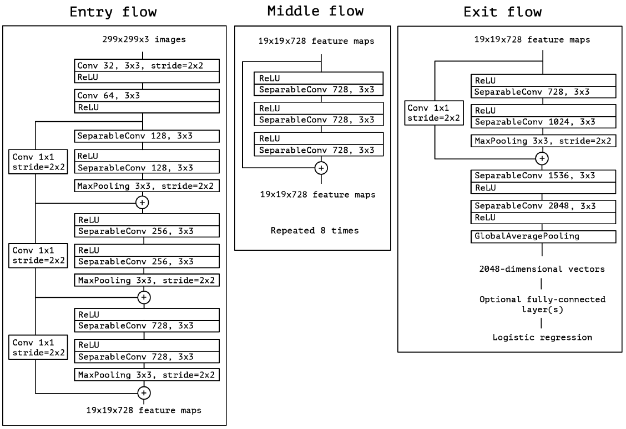
ICDLC Deep Neural Network Overview
Based of Xception network
Change “Entry flow” from
299x299x3 to 256x256x4
Change “Exit flow” to be
inverse of “Entry flow”, with
MaxPooling being replace by
UpSampling
Network output 256x256x2,
corresponding to predicted CbCr
values of image

Slide 8
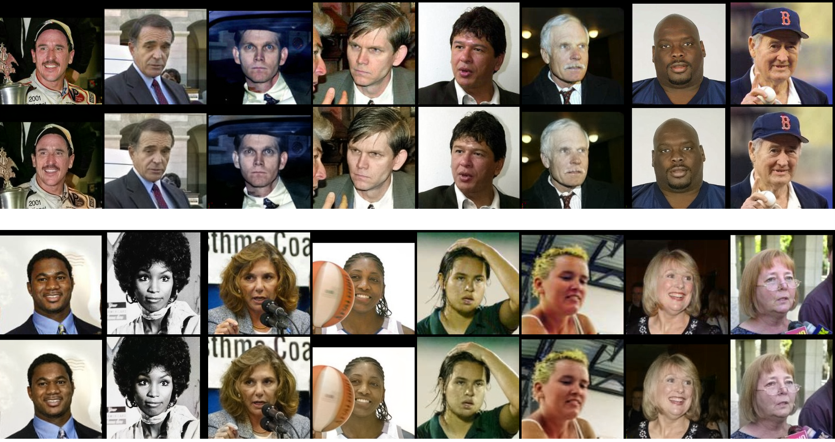
Test Output Examples
Original
Predicted
Original
Predicted

Slide 9
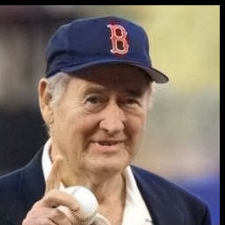

Test Output Examples (cont.)

Slide 10
Test Output Examples (cont.)
Predicted (PSNR = 33.5204 dB)
Original

Slide 11

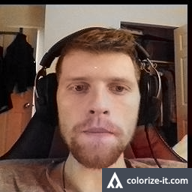
Custom Examples and Comparisons
Original
ICDLC (PSNR = 36.6264 dB)
Colorful Image Colorization

Slide 12
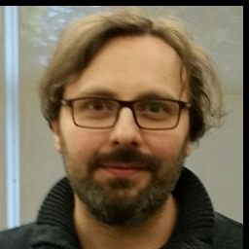
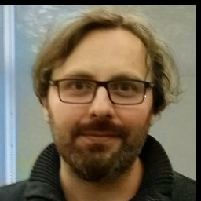
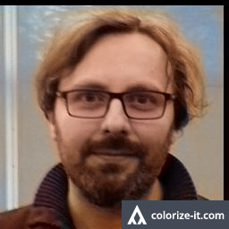
Custom Examples and Comparisons
Original
ICDLC (PSNR = 30.2879 dB)
Colorful Image Colorization

Slide 13
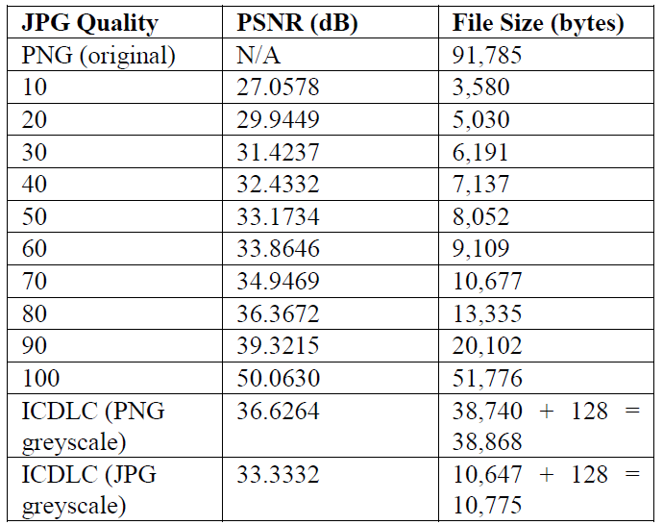
ICDLC Results
Average PSNR of Test Images ~35 dB
ICDLC vs. JPG
PNG Greyscale
80 JPG quality, 90-100 JPG size
JPG Greyscale
50-60 JPG quality, 70 JPG size
Currently ICDLC is slightly worse than JPG (but can be yet improved)
PSNR not ultimate calculation if good or not

Slide 14
Future Improvements
Better Edge Detection
Longer training time (currently only 8.5 hours on Tesla K80)
Increase Dataset
Any image size as input
Add fusion layer, detect more than faces

Slide 15

Questions

Slide 16
References
[1] R. Zhang, P. Isola and A. A. Efros, Colorfur Image Colorization.
[2] S. Iizuka, E. Simo-Serra and H. Ishikawa, "Let there be Color!: Joint End-to-end Learning of Global and Local Image Priors".
[3] F. Chollet, "Xception: Deep Learning with Depthwise Separable Convolutions".
[4] University of Massachusetts, "Labeled Faces in the Wild: A Database for Studying Face Recognition in Unconstrained Environments," [Online]. Available: http://vis-www.cs.umass.edu/lfw/#download. [Accessed 26 October 2018].
[5] taehoonlee, "GitHub," [Online]. Available: https://github.com/keras-team/keras-applications/blob/master/keras_applications/xception.py. [Accessed 18 November 2018].
[6] E. Wallner, "Colorizing B&W Photos with Neural Networks," FloydHub, [Online]. Available: https://blog.floydhub.com/colorizing-b-w-photos-with-neural-networks/. [Accessed 27 September 2018].

